Slide 1
Module 5
File created on: 8/9/2021 5:15:17 AM

Slide 2
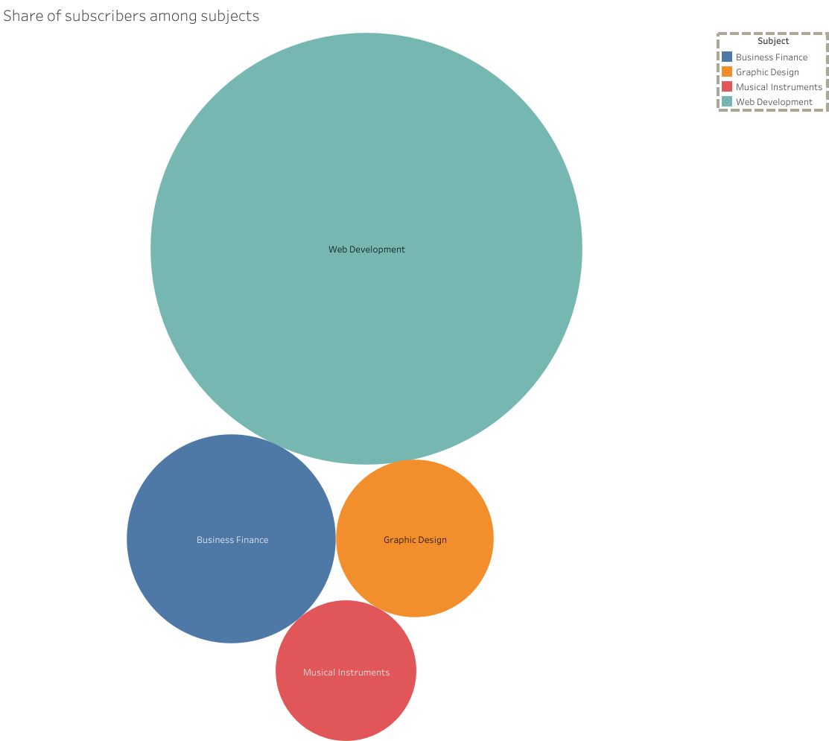

Slide 3


Slide 4


Slide 5


Slide 6


Slide 7


Slide 8
